Slide 1
The Role of Tipperary County Council in Economic Development
September 2014
Sinead Carr Director of Services
Tipperary County Council

Slide 2
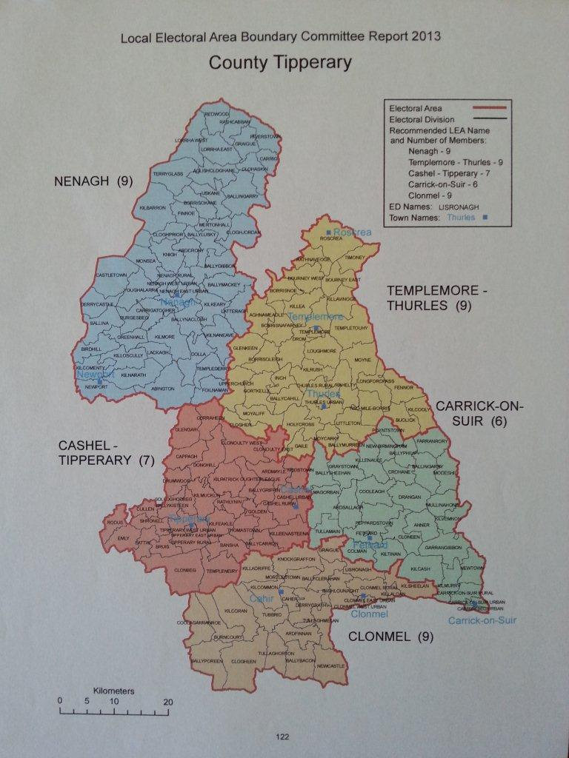

Slide 3
The Role of Local Authorities in Economic Development and Job Creation
LA’s have always been involved in economic development
Traditional understanding of role is in the area of provision of
Roads
Water
Land zoning (Development Plan)
Streetscape improvement and cleaning
Use of derelict sites to develop town centre initiatives (urban renewal areas, village enhancement areas etc)
Strategic land bank purchase
“Traditional focus” is an important and critical platform for laying a sustainable and robust basis upon which the broader economy can grow and develop
Critical to the effectiveness of other enterprise support agencies

Slide 4
The Role of Local Authorities in Economic Development and Job Creation
Purpose of today is to
Explain the broadened role of LAs and the structural changes
LA’s are now the key link between the business communities, the variety of economic agencies and the service receivers at local level.
Outline the areas that may be of benefit to you in supporting your business to grow

Slide 5
Additional Areas – Structural Change
Strategic Policy Committee for Local Authorities
Deliver economic policy for the entire county and have input from key economic agencies and businesses
Integration of the County Enterprise Board into the Local Authority to provide a First Stop Shop – Local Enterprise Office (LEO)
Will be contact point for business start up funds and expansion funds, supports, training, marketing, planning, rates advice, licences and regulations
Alignment of the Local Development Companies with Local Authorities in order to reduce duplication and ensure maximum value to the client
Business grants and feasibility supports to rural enterprises not covered by the LEO
The Council now supports economic development officers to assist in rolling out economic initiatives, developing appropriate policies and working closely with businesses to assist them in their area of activity – not just confined to old CEB type activity

Slide 6
Why the Structural Changes?
The Programme for Government has recognised that the needs of businesses are complex and multi-dimensional
Structure of economic agencies did not always lend themselves to dealing in a flexible manner to the needs of enterprises and businesses and indeed missed out on key sectors
None of the myriad of enterprise agencies currently in existence operate across the entire breadth of the business sector types
It identified the need for a one stop shop for the business community
The economic support system up to now has resulted in lost opportunities for collaboration between businesses themselves and between agencies and businesses - in particular
The complex linkages between industries can be missed and the opportunity to feed off firms of different size and type
Opportunities lost in terms of developing more “inter-connectiveness” between sectors
Opportunities lost in context of sub supply options and the opportunities to link up supports between firms of different sizes and different markets
Given the positioning of local authorities, it was considered that they were best placed to assist in meeting gaps

Slide 7
Examples of LA Supports
The next number of slides give a very brief glimpse of some of the wide ranging initiatives that have been or will be undertaken/initiated/facilitated by Tipperary County Council. For ease of reference , slides will be grouped as
Policy initiatives
Strategic initiatives
Linkage Initiatives
Promotional Initiatives
Information Initiatives
Other Initiatives

Slide 8
Policy Initiatives
LA is currently reviewing the impact of its policies on economic growth in the new County which includes
Reviewing the development contribution scheme and exploring the options around some form of a partial waiver where economic development is proposed in an area zoned for economic development;
development plan – a new all county development plan will be prepared and will give particular attention and focus to supporting new initiatives to assist small start up enterprises in the county and to sustain existing;
Struggling businesses are being actively encouraged to link with the finance section and a supportive approach to payment of rates/charges/contributions is being managed for such businesses;
linkage provided through planning applications with LEO (business plans); LDC (grants etc) in order to ensure that they are facilitated in as far as this is possible to take up or at least examine the potential for grant aid, training or mentoring support

Slide 9
Strategic Initiatives
LA, in it’s collaboration with other agencies has developed a practical approach to economic development which is linked in with the needs of businesses. Examples include
the collaborative approach to the development of a Tipperary Science and Technology Campus in Clonmel which is a collaborative effort between STCC; the IDA and LIT Tipperary
The Development of Community Enterprise Parks to provide much needed start up incubation space such as the Carrigeen Business Park, Clonmel; the Thurles Enterprise Centre, Drangan Business Park, and Ballingarry Business park among others (with the assistance of Enterprise Ireland, Chambers of Commerce and local communities)
The roll out of Metropolitan Area Networks (broadband infrastructure) in the towns of Clonmel, Tipperary, Carrick on Suir, Cahir Cashel and currently being rolled out in Nenagh, Roscrea, Templemore and Thurles
Tipperary County Council will continue to identify opportunities and work up solutions to deliver important economic infrastructure where it is required for business to grow

Slide 10
Linkage Initiatives
Linkage initiatives undertaken to date by the Council would include
Working with businesses individually to link them in with key available supports
Linking tenants in the business parks with the relevant economic and educational agencies (including 3rd level) which has initiated valuable initiatives for the businesses themselves
Working with businesses to raise their awareness of funding opportunities; grant opportunities and linkage opportunities - particularly those who had not previously been service users of the CEB or EI supports
Linking businesses in with non local support agencies such as Intertrade Ireland’s Acumen Programme; “Going Global” EI grant; Feasibility studies through EI; FP7 funding support ; Innovation Vouchers ; SEI funding opportunities etc
Council has also contributed to and worked with the IDA; EI; LEO and others in promoting entrepreneurship workshops and events (Innovate to Compete; Fresh Start; Unemployment Fair ; “Who To Talk To” Events etc)

Slide 11
Promotional Initiatives
The LA has and is working with business communities to undertake international, national and regional promotional initiatives as the opportunity arises. This includes
Assist, support and part fund the organisation of cultural festivals/events
in particular to link the retail trade with the softer supports of arts, heritage, sport and culture initiatives given their importance in attracting and sustaining employment initiatives/increasing footfall and spend;
Develop a promotional video on an all county basis
Celebrate and promote enterprise activity in Tipperary – A number of rolling initiatives to be developed could include civic receptions to key business achievers; a number of high profile launches of a number of economic initiatives ; positive coverage of the various economic achievements/events by the local and national media etc
Intention – sell Tipperary as a positive, proactive and enterprise friendly place to do business

Slide 12
Information Initiatives
A County Data Unit has been set up - appropriate statistical information for any business who requires county wide statistical information for the purpose of growing its business. www.southtipperaryinfo.ie
Re- development of a Tipperary Business Information Website -information on the economic and entrepreneurial supports in Tipperary are available on line - to be progressed
Support the development , sustainment and setting up of appropriate business networks in Tipperary– purpose is to provide an appropriate networking platform for like minded businesses and to deliver supports to key sectors in a format that meets their needs
Through the business networks - disseminate information on the opportunities available in the export and procurement areas ; hold information sessions on demystifying the exporting & procurement process; identify the supports available and use the experience of businesses who have already successfully gone through the process to promote these opportunities

Slide 13
Other Initiatives
Development of a specific Integrated Retail Action Plan - energise and support the retention and expansion of the retail sector in the whole of Tipperary (Collaborative marketing programmes; supporting festivals/events, working with retail trade in large and small towns to develop bundles of attractions; develop grant schemes for vacant shops, promoting and supporting social media training, linking in with existing art/sporting festivals to leverage greater value for the retail sector etc).
Support the setting up of an all County Tourism Company in conjunction with the tourism trade in order to promote, develop and market tourism in Tipperary
Develop the tourism infrastructural product in Tipperary
To continue to work with the relevant agencies to attract significant employers to their county
Act as the local link with the existing employers, address their requirements and assist them to expand/win contracts for expansion & attract employees where this is requested
Act as the supportive link with businesses who are closing/downsizing - linking in with employees & assessing their needs and opportunities; identifying skill sets; assisting with information supports; supporting and mentoring those who wished to start their own business. Always well received by both sides

Slide 14
Conclusion
Tipperary County Council is acting as a first stop shop for existing and potential businesses and entrepreneurs (irrespective of size or type) in relation to the myriad of supports, grants, and assistance that are available at both regional and local level from all economic support agencies
TCC intends to act as the local champion to ensure delivery of integrated supports between the enterprises of different scale and type
TCC will act as the central statistical hub for the County – analysing economic trends and indicators; supplying information to support applications and attract inward investment
TCC will provide a consultative mechanism to facilitate economic input to the drafting of National Regional County Economic Plans (and other Plans) which will impact on the ability of the County to develop on an appropriate sustainable economic basis .

Slide 15
Conclusion
TCC is aware that central to the economic success of Tipperary is the sustainment, and growth of the indigenous SME sector in particular.
Tipperary County Council is committed to working with the business community to ensure that they are enabled and facilitated to develop to their maximum capacity and make their contribution to a vibrant and sustainable economic county unit.
We look forward to working with you over the next couple of decades and hope you will actively engage with us in ensuring we have the appropriate policies, supports and assistance available to meet your needs

Slide 16
THANK YOU
Sinéad Carr
Director of Services for Economic & Community Development
Tipperary County Council

